Slide 1
Cell Division
Mitosis and Meiosis

Slide 2
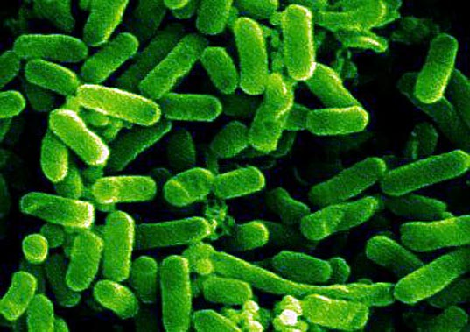
Cell Growth and Division
Cells can grow at astonishing rates.
Some cells, like E-coli, can double their volume in 30 minutes and divide in 30 minutes
Ideal conditions of cell growth can never be maintained for very long.
*Cells grow until they come into contact with other cells.

Slide 3
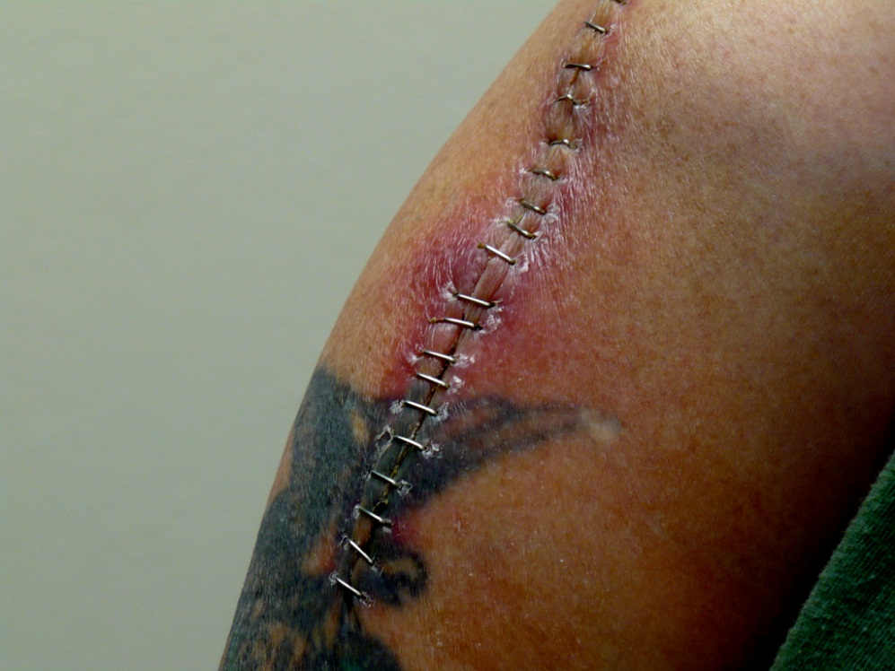
Cell Growth and Division
Cell Division can be turned off and on.
Turns on when we have an injury, cut or bone break.
Cells at edge of injury grow fast - growth slows down as the injury becomes healed.

Slide 4
Cell Growth and Division
Some cells divide and grow very rapidly and some rarely divide.
Skin cells & cells of the Digestive Tract grow and divide throughout our life.
Cells of our Heart and Nervous System will do this only rarely.

Slide 5
Eukaryotic Chromosomes
Eukaryotic chromosomes –
-linear chromsomes
-every species has a different number of chromosomes
-composed of chromatin – a complex of DNA and proteins
-heterochromatin – not expressed
-euchromatin – expressed regions

Slide 6
Eukaryotic Chromosomes
Chromosomes are very long and must be condensed to fit within the nucleus.
-nucleosome – DNA wrapped around a core of 8 histone proteins
-nucleosomes are spaced 200 nucleotides apart along the DNA
-further coiling creates the 30-nm fiber or solenoid

Slide 7
Eukaryotic Chromosomes
Chromosomes must be replicated before cell division.
-Replicated chromsomes are connected to each other at their kinetochores
-cohesin – complex of proteins holding replicated chromosomes together
-sister chromatids: 2 copies of the chromosome within the replicated chromosome

Slide 8
Chromosomes
Chromosomes = Structures that contain genetic information.
- Means colored body because when dye is added the Chromosomes pick up the color so we can see them.
- Made of material called Chromatin which is made up of DNA and Protein.
- Humans contain 46 chromosomes - 23 from each parent.

Slide 9
Chromosomes
Made up of two Chromatids. these are the large thread structures. Each Chromosome has 2.
The Chromatids are attached at an area called the Centromere.

Slide 10
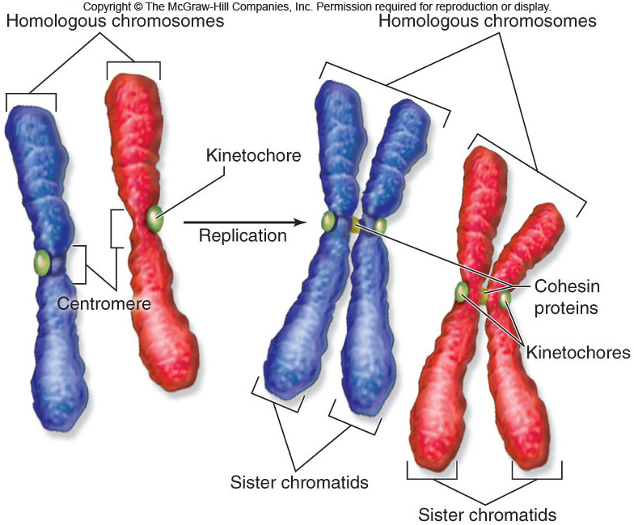

Slide 11
What you must know:
The structure of the replicated chromosome.
The events that occur in interphase of the cell cycle (G1, S, G2).
The role of cyclins and cyclin-dependent kinases in the regulation of the cell cycle.
Ways in which the normal cell cycle is disrupted to cause cancer or halted in certain specialized cells.
The features of mitosis that result in the production of genetically identical daughter cells including replication, alignment of chromosomes (metaphase), and separation of chromosomes (anaphase).

Slide 12
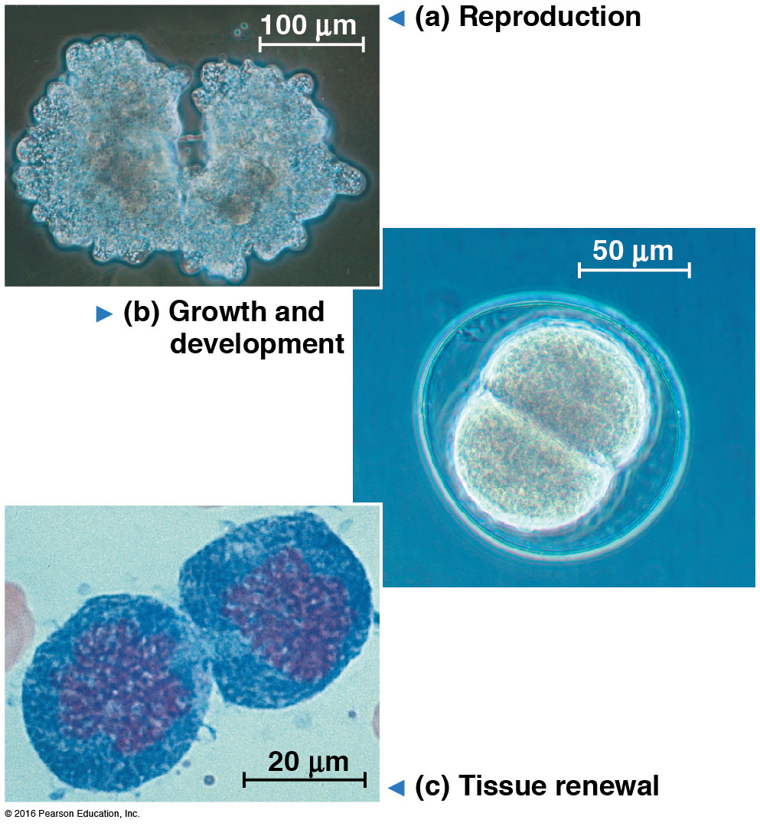
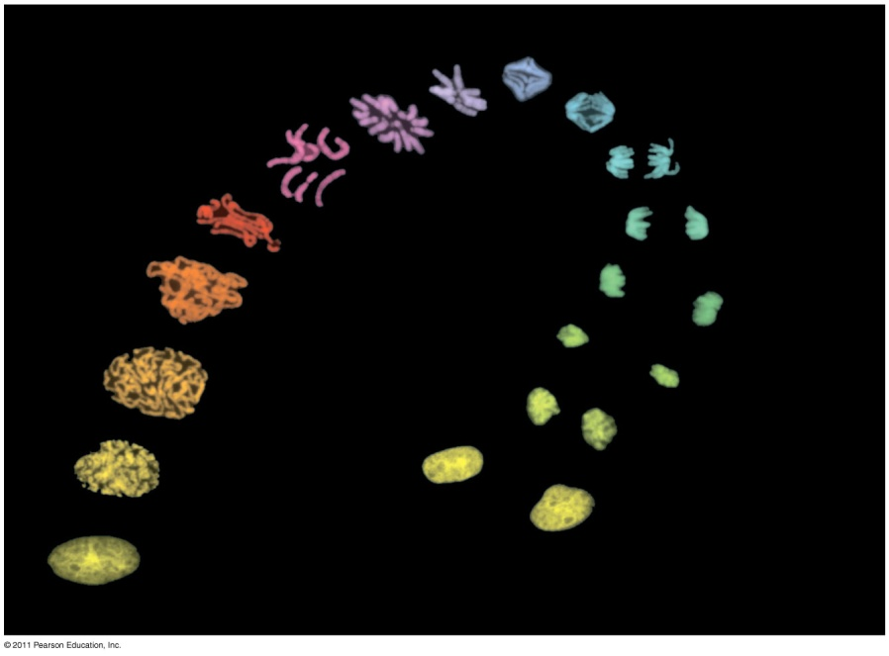
Cell Cycle: life of a cell from its formation until it divides into two cells
Functions of Cell Division: Reproduction, Growth and Tissue Repair

Slide 13
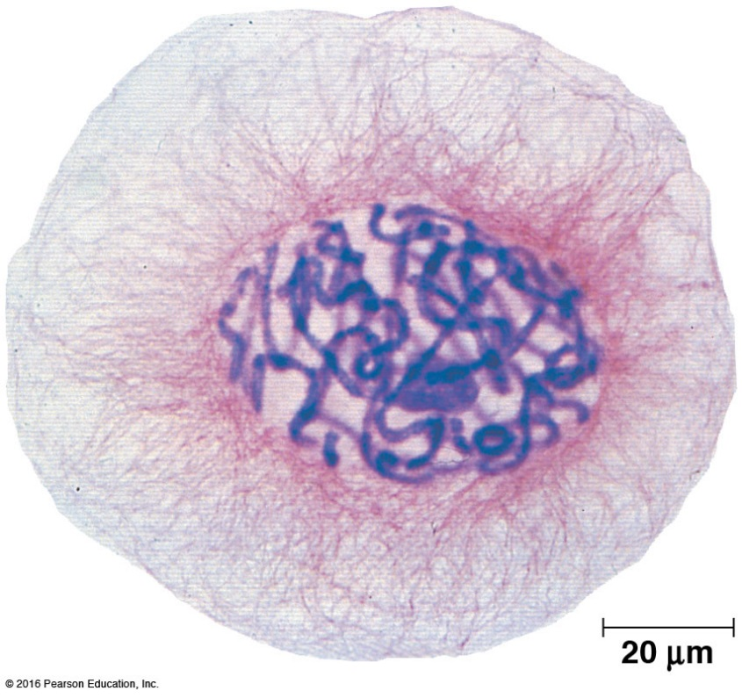
Genome = all of a cell’s genetic info (DNA)
  Prokaryote: single, circular chromosome
  Eukaryote: more than one linear chromosomes
    Eg. Human:46 chromosomes, mouse: 40, fruit fly: 8

Slide 14
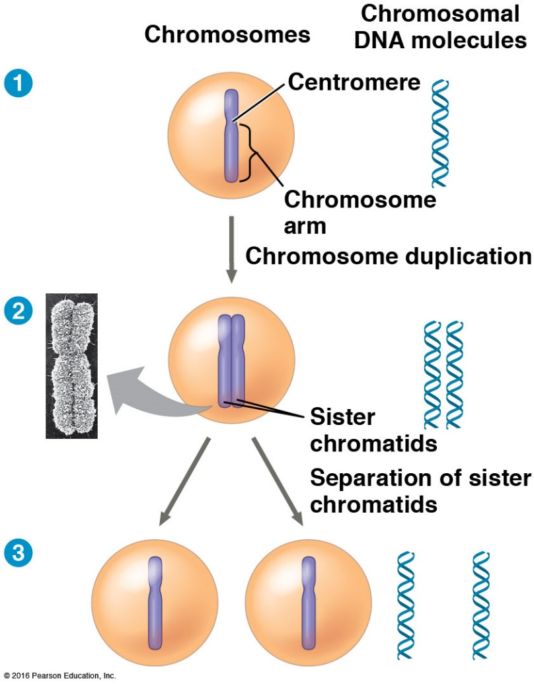
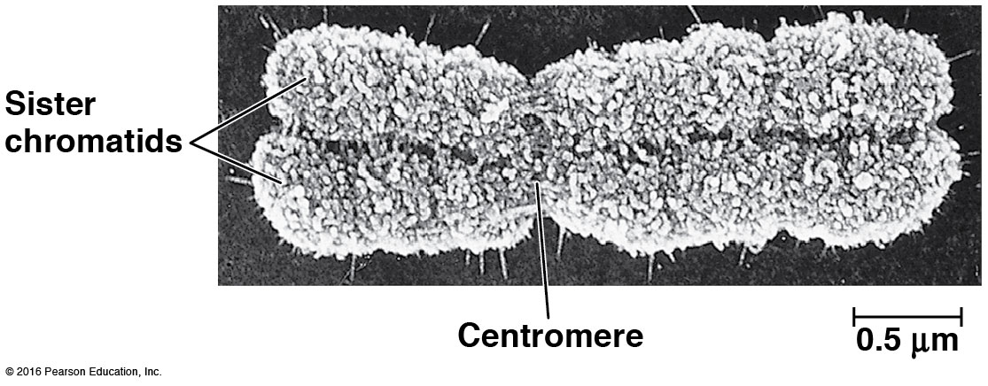
Each chromosome must be duplicated (replicated) before cell division
Duplicated chromosome = 2 sister chromatids attached by a centromere

Slide 15
Somatic Cells
Gametes
Body cells
Diploid (2n): 2 of each type of chromosome
Divide by mitosis
Humans: 2n = 46
Sex cells (sperm/egg)
Haploid (n): 1 of each type of chromosome
Divide by meiosis
Humans: n = 23

Slide 16
CELL DIVISION
A cell divides and produces two identical cells. (a mother cell splits in half to make two daughter cells that are genetically identical).

Slide 17
CELL DIVISION
Mitosis: The process in which the nucleus divides to produces two identical nuclei.
Cytokinesis: The process in which the cytoplasm divides to produces two new cells.

Slide 18
Eukaryotic Cell Cycle
The eukaryotic cell cycle has 5 main phases:
1. G₁ (gap phase 1)
2. S (synthesis)
3. G₂ (gap phase 2)
4. M (mitosis)
5. C (cytokinesis)
The length of a complete cell cycle varies greatly among cell types.
interphase

Slide 19
Interphase
Interphase: The period between cell division. (can be a long time).
The nucleus is active in producing messenger RNA. Proteins are made, and DNA is copied.

Slide 20
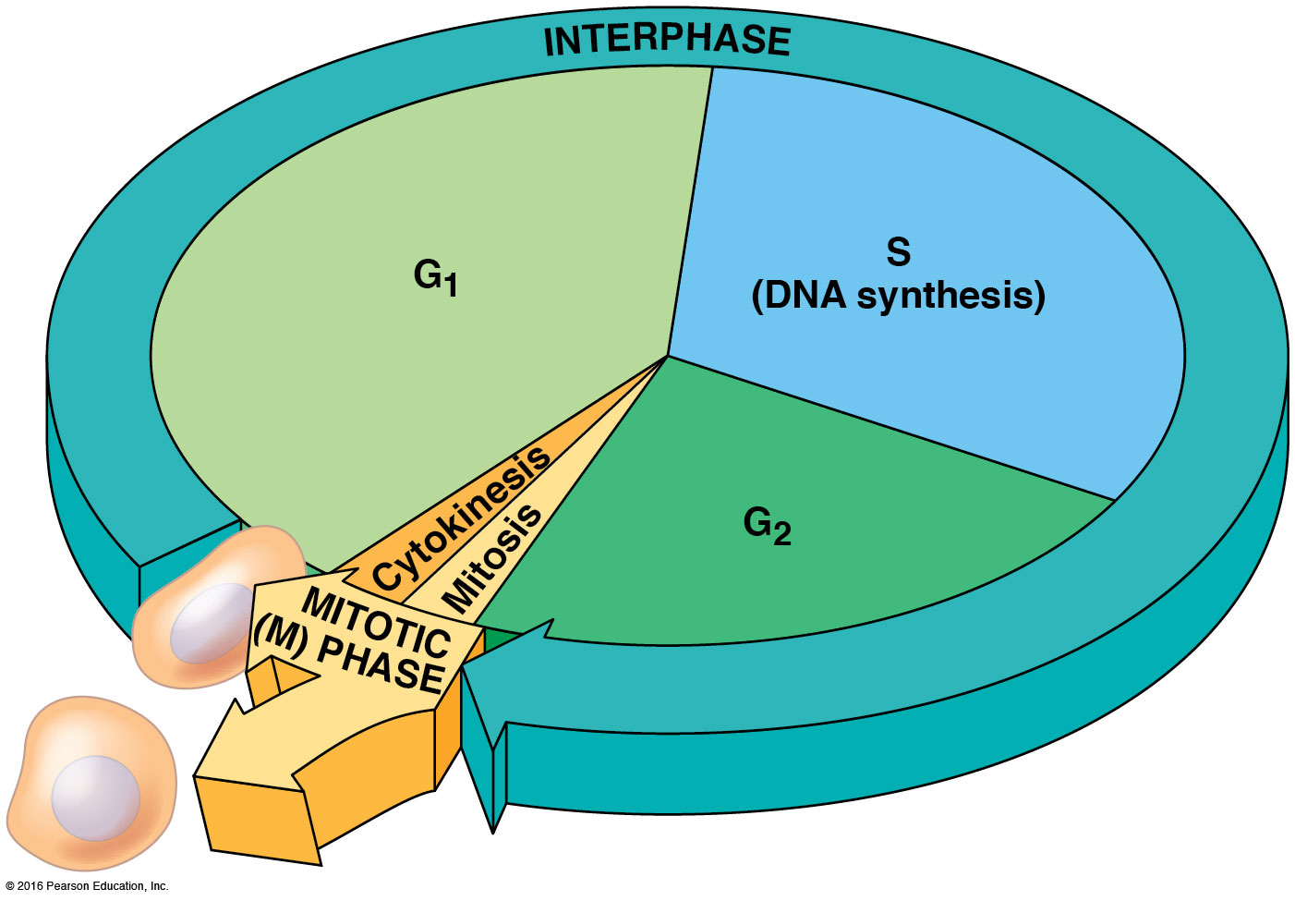
Phases of the Cell Cycle

Slide 21
Interphase
Interphase is composed of:
G₁ (gap phase 1) – time of cell growth
S phase – synthesis of DNA (DNA replication)
- 2 sister chromatids are produced
G₂ (gap phase 2) – chromosomes condense

Slide 22
Interphase
Following S phase, the sister chromatids appear to share a centromere.
In fact, the centromere has been replicated but the 2 centromeres are held together by cohesin proteins.
Proteins of the kinetochore are attached to the centromere.
Microtubules attach to the kinetochore.

Slide 23
Mitosis
Mitosis is divided into 4 phases:
1. Prophase
2. metaphase
3. anaphase
4. telophase

Slide 24
Mitosis
1. Prophase: Nuclear envelope disappears. chromosomes become visible. Centrioles move to opposites sides of the cell and form spindles (threads). Chromosomes replicate to form two chormatids connected in the middle by centromere.

Slide 25
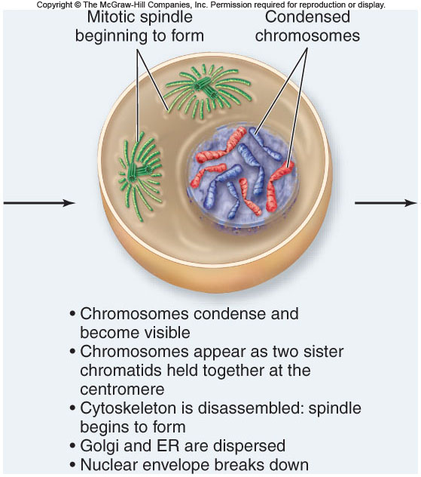
Prophase

Slide 26
Metaphase
2. Metaphase: chromosomes line up in the middle of the cell. the spindles from the centrioles connect to the centromeres.

Slide 27
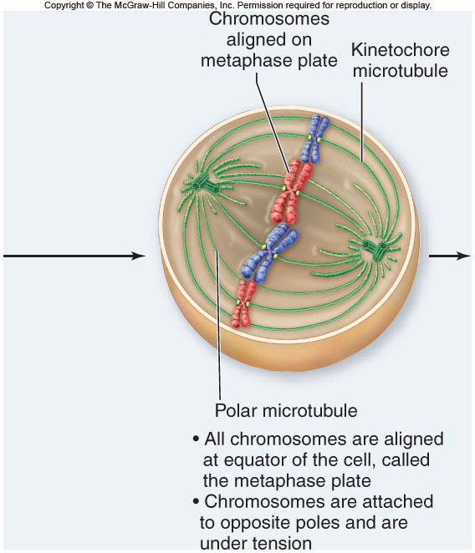

Slide 28
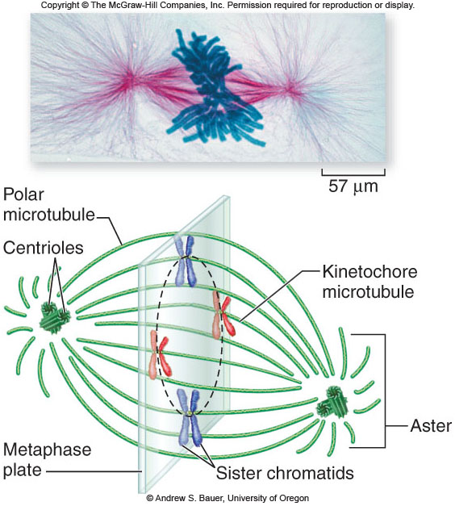

Slide 29
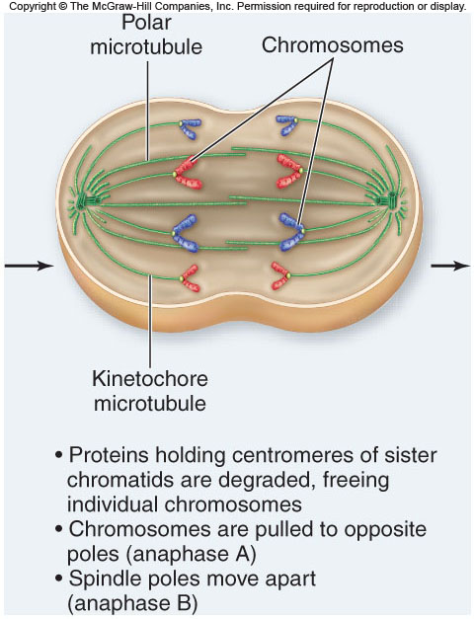
3. Anaphase: the two chromatids are pulled apart to opposites sides of the cell by the spindles. (once the chromatids are pulled apart, they are called chromosomes).

Slide 30
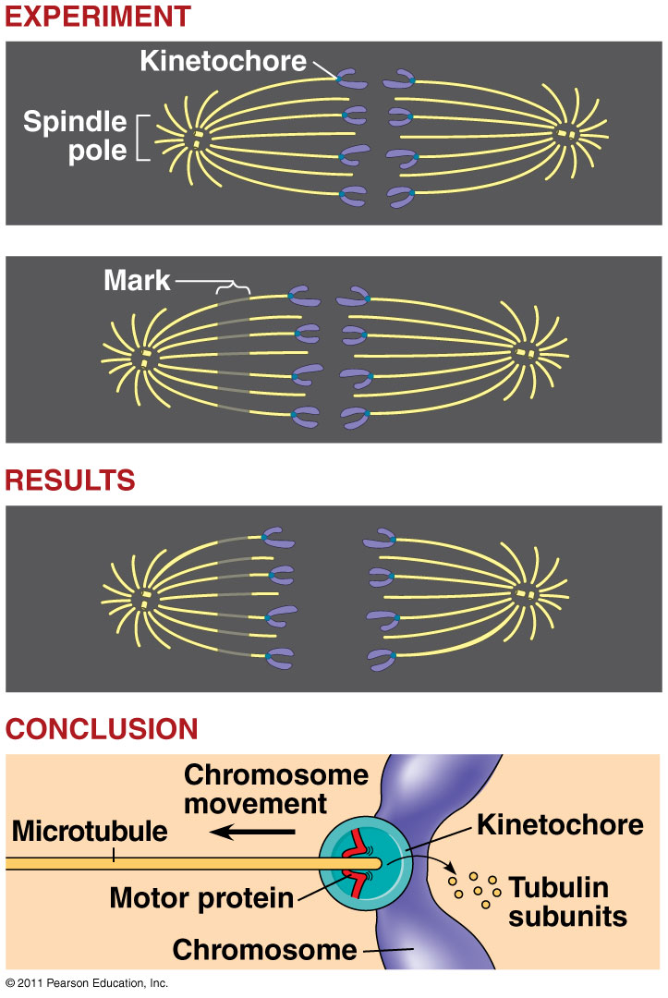
During anaphase
Chromosomes walked to poles by motor proteins
Kinetochore microtubules shorten at ends as they depolymerize

Slide 31
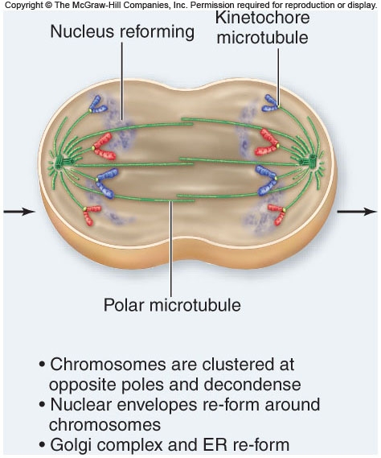
4. Telephase: The final phase of mitosis. The chromosomes located at both sides of the cell uncoil and nuclear envelope reforms.

Slide 32
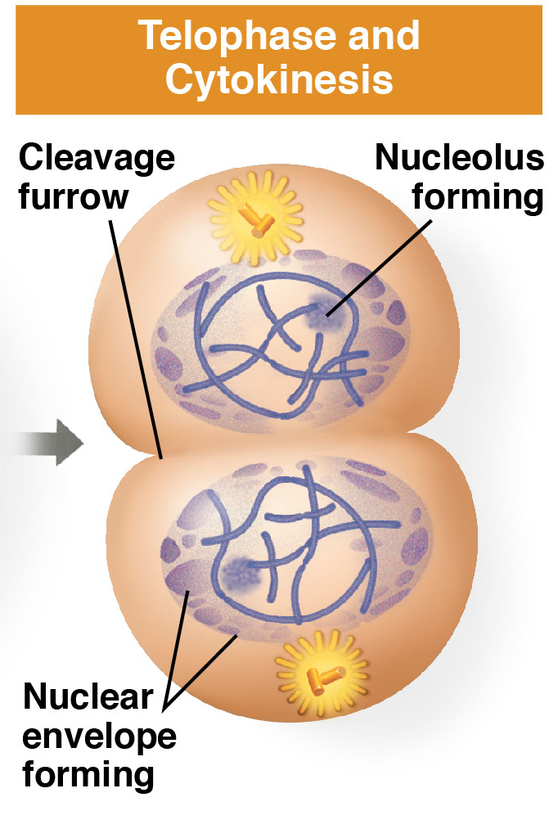
Telophase & Cytokinesis
Cytokinesis
  Cytoplasm of cell divided
  Animal Cells: cleavage furrow
  Plant Cells: cell plate forms

Slide 33
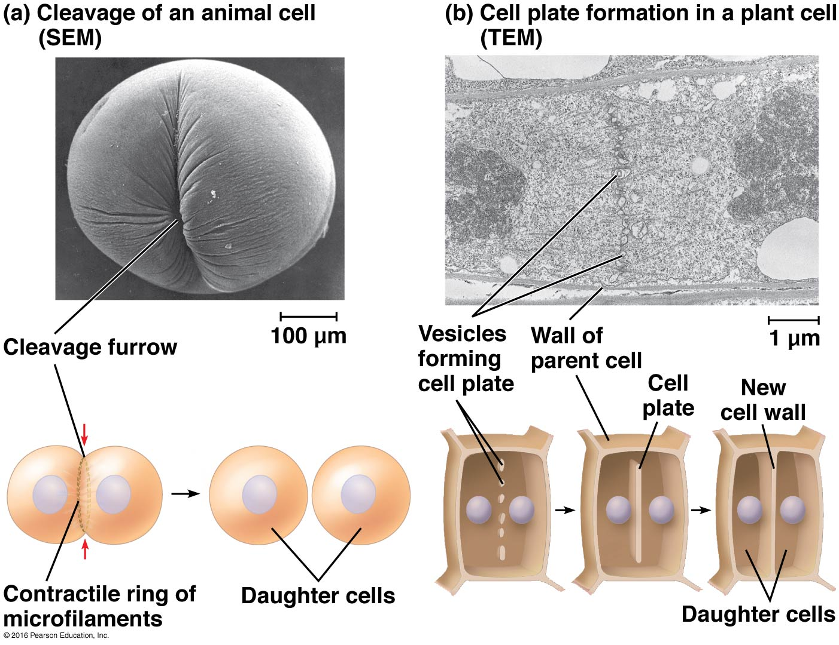
Cytokinesis in Animal vs. Plant Cells

Slide 34
Cytokinesis:
Once the genetic material is divided in two (mitosis), the cell (Cytoplasm) now splits into two daughter cells.
In animals:; The cell membrane pinches in the middle to form two new cells.
In plants: A cell plates forms in the middle of the cell. A cell wall will form at the cell plate to form two new cells.

Slide 35
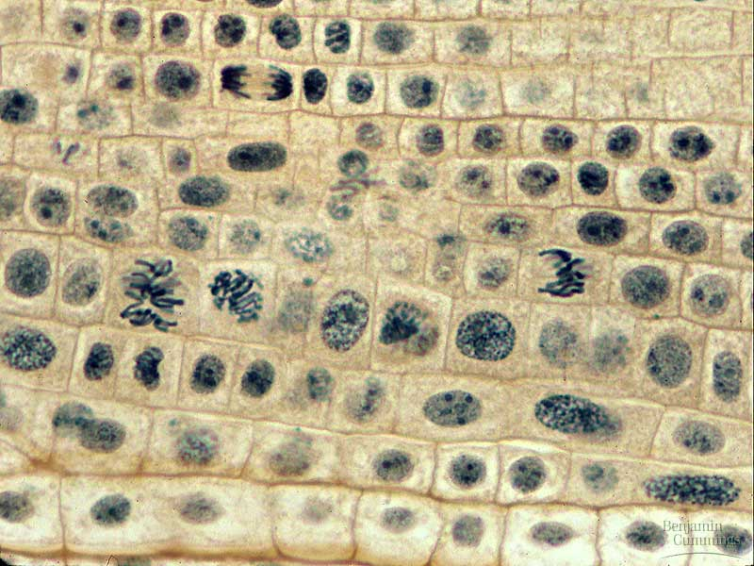
Which phases of the cell cycle can you identify?

Slide 36
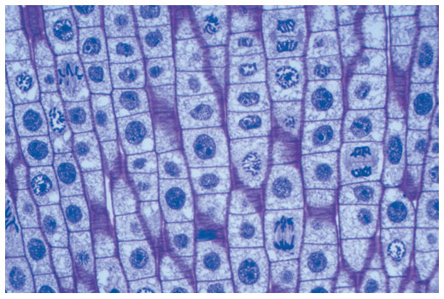
Which phases of the cell cycle can you identify?

Slide 37
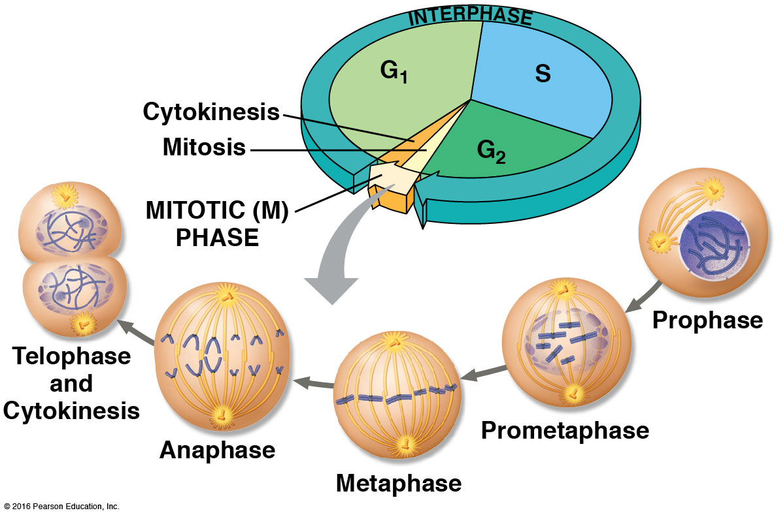
Summary of the Cell Cycle

Slide 38
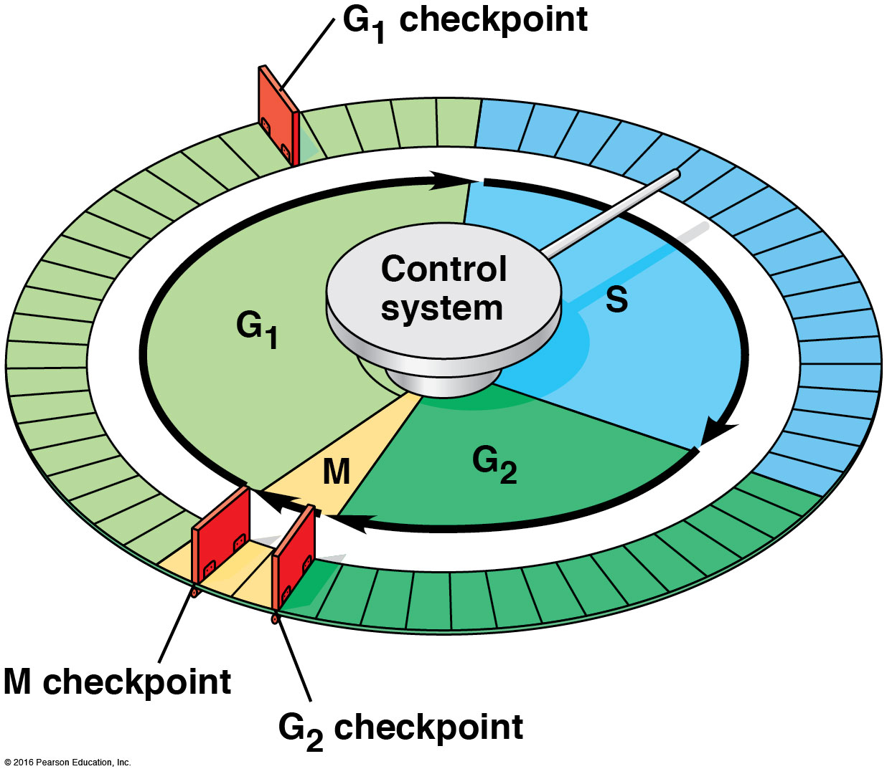
Cell Cycle Control System
Checkpoint = control point where stop/go signals regulate the cell cycle

Slide 39
Major Checkpoints
G₁ checkpoint (Most important!)
  Controlled by cell size, growth factors, environment
  “Go” → completes whole cell cycle
  “Stop” → cell enters nondividing state (G₀ Phase)
    Nerve, muscle cells stay at G₀.
    liver cells called back from G₀
G₂ checkpoint
    Controlled by DNA replication completion, DNA mutations, cell size
M-spindle (Metaphase) checkpoint
  Check spindle fiber (microtubule) attachment to chromosomes at kinetochores (anchor sites)

Slide 40
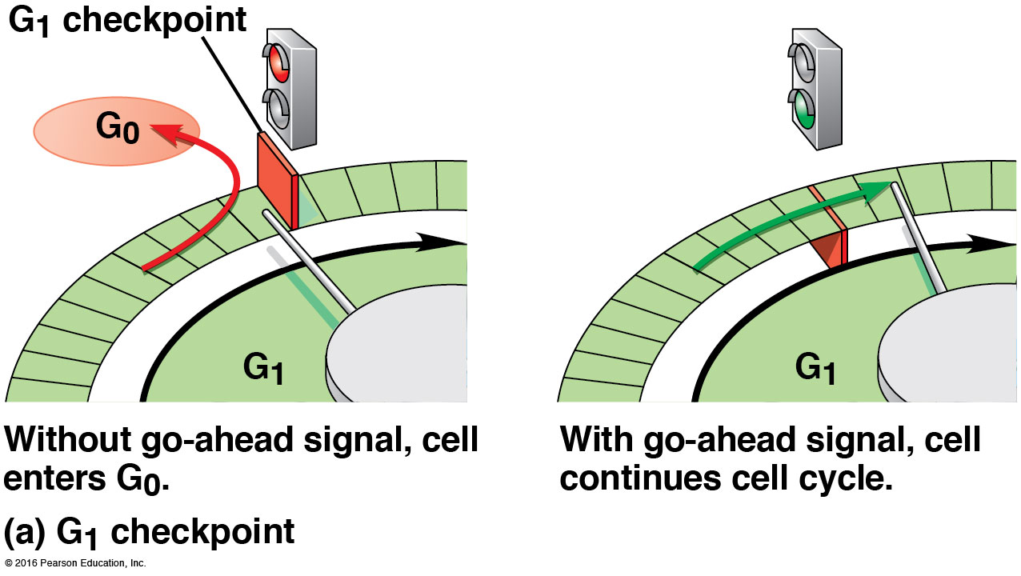
G₁ Checkpoint

Slide 41
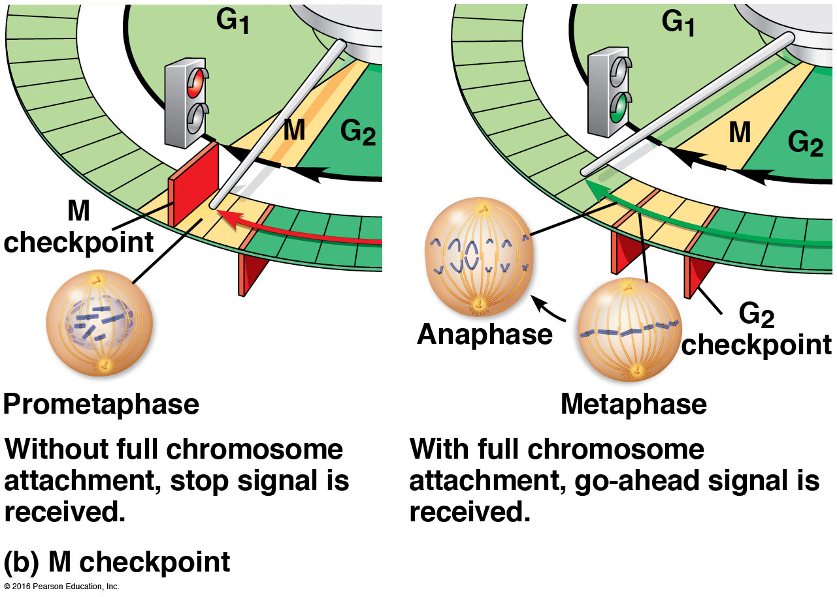
M Checkpoint

Slide 42
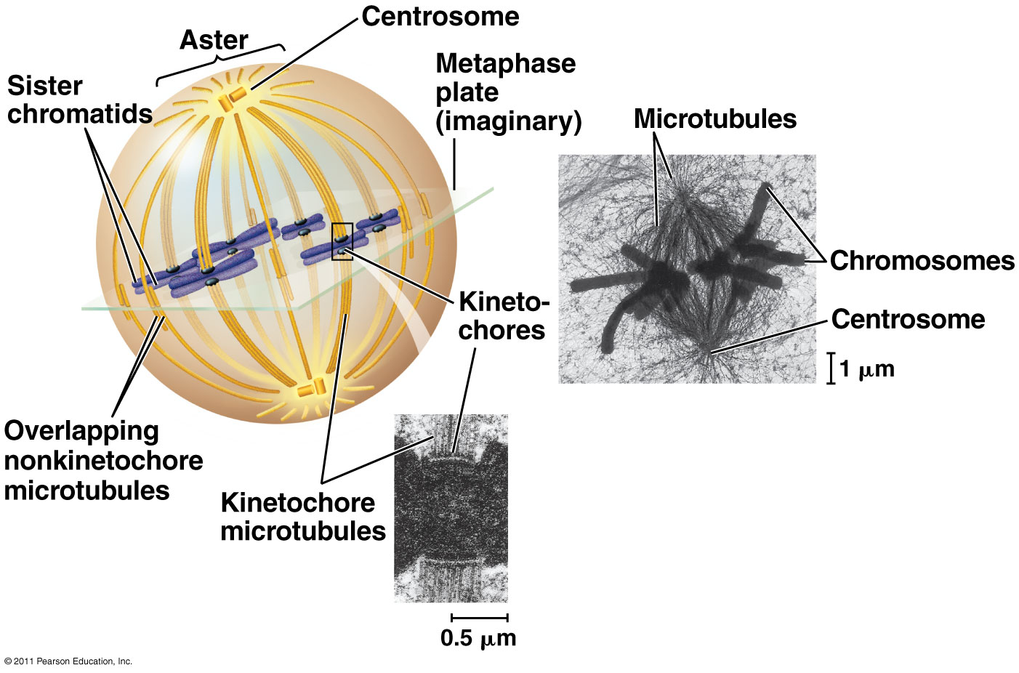
M-spindle Checkpoint:
Mitotic spindle at metaphase
Kinetochore = proteins associated with DNA at centromere

Slide 43
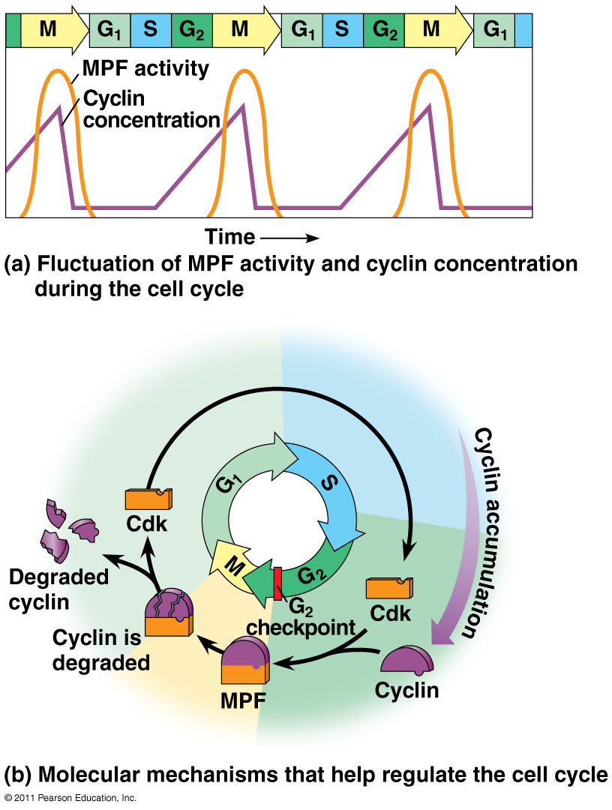
Internal Regulatory Molecules
Kinases (cyclin-dependent kinase, Cdk): protein enzyme controls cell cycle; active when connected to cyclin
Cyclins: proteins which attach to kinases to activate them; levels fluctuate in the cell cycle

Slide 44
Internal Regulatory Molecules
MPF = Maturation-Promoting Factor
  specific cyclin-Cdk complex which allows cells to pass G₂ and go to M phase

Slide 45
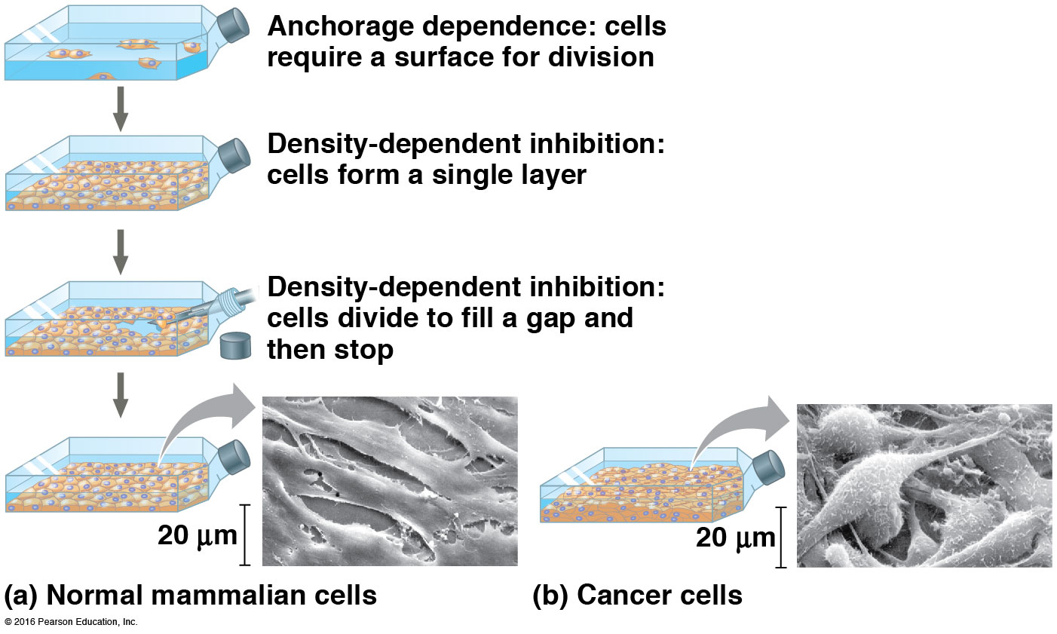
External Regulatory Factors

Slide 46
External Regulatory Factors
Growth Factor: proteins released by other cells to stimulate cell division
Density-Dependent Inhibition: crowded cells normally stop dividing; cell-surface protein binds to adjoining cell to inhibit growth
Anchorage Dependence: cells must be attached to another cell or ECM (extracellular matrix) to divide

Slide 47
Bacterial Cell Division
Bacteria divide by binary fission.
-the single, circular bacterial chromosome is replicated
-replication begins at the origin of replication and proceeds bidirectionally
-new chromosomes are partitioned to opposite ends of the cell
-a septum forms to divide the cell into 2 cells

Slide 48
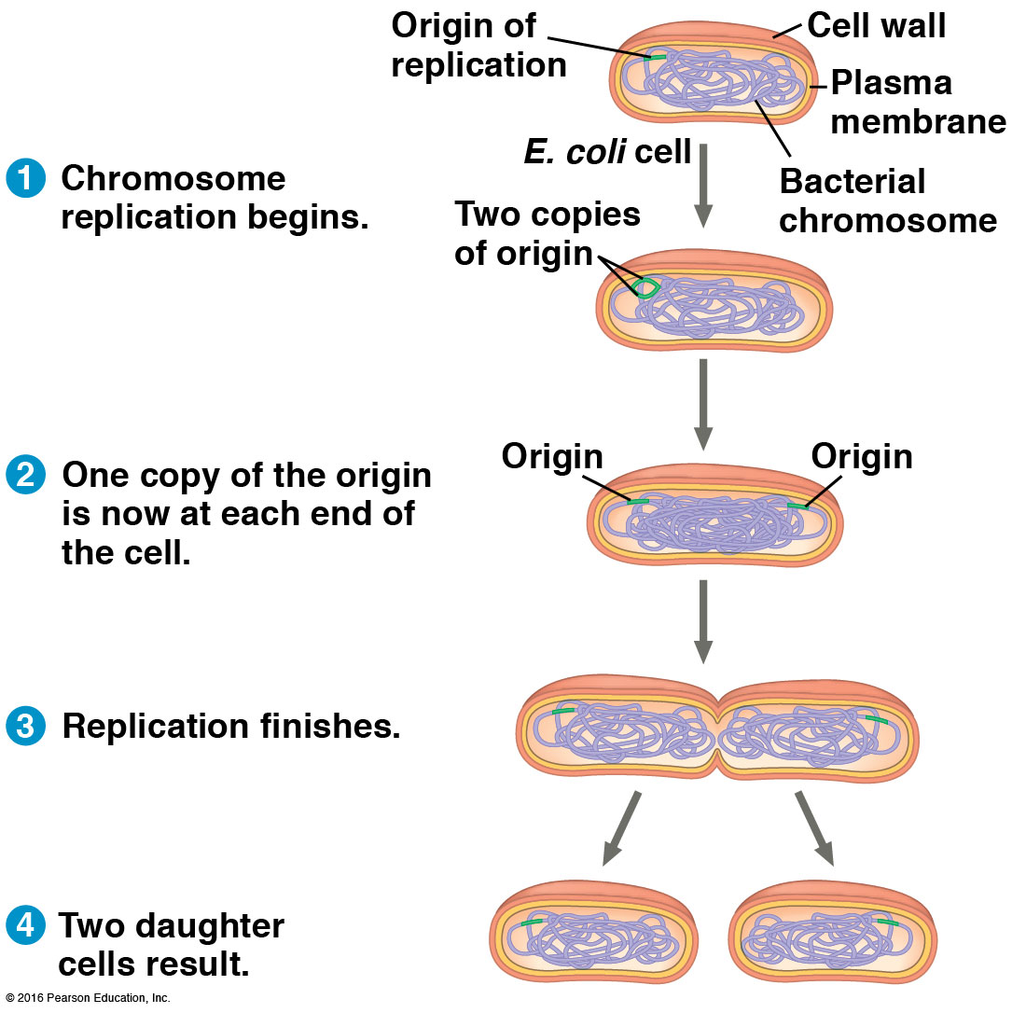
Bacterial cells divide by Binary Fission

Slide 49
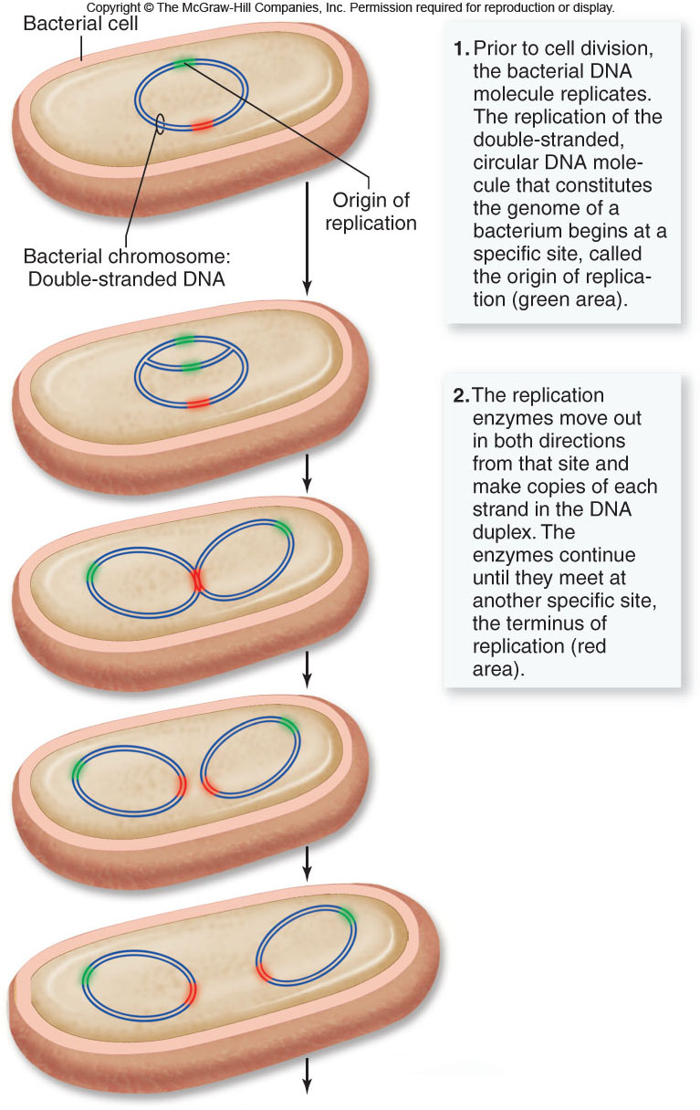

Slide 50
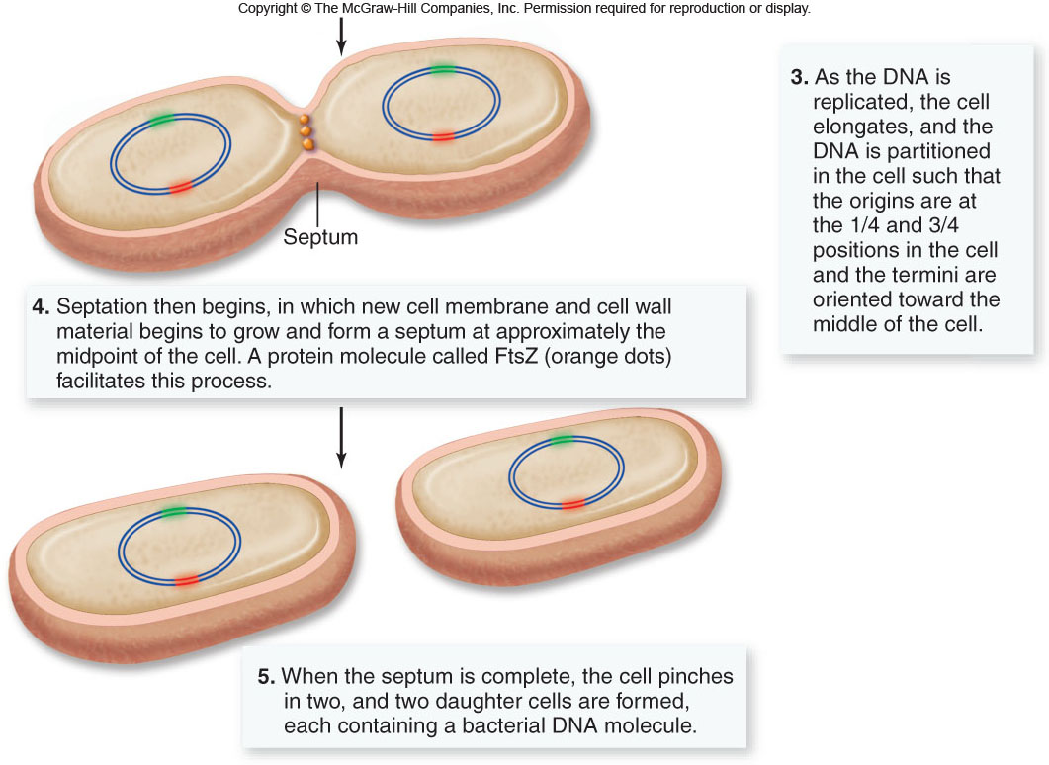

Slide 51
Uncontrolled Cell Growth
Cancer is caused by uncontrolled cell growth.
The cell growth is controlled by DNA.
The DNA is changed by viruses in many cases, causing the cell's chromosomes to be changed, altering their normal functions.
- These cells do not stop dividing when they come in contact with each other.

Slide 52
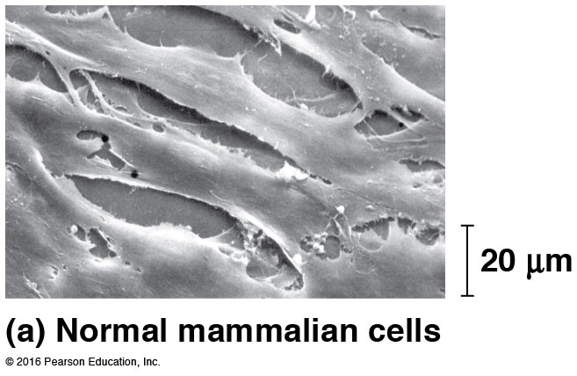
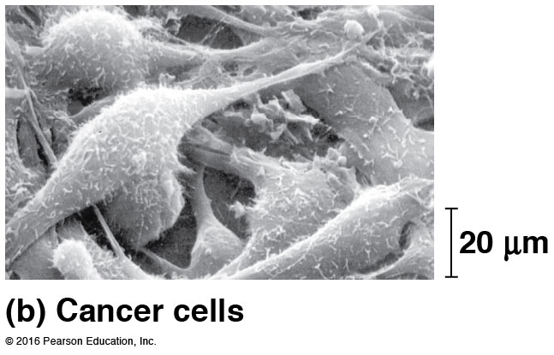
Cancer Cells
Cancer: Disorder in which cells lose the ability to control growth by not responding to regulation.
multistep process of about 5-7 genetic changes (for a human) for a cell to transform
loses anchorage dependency and density-dependency regulation

Slide 53
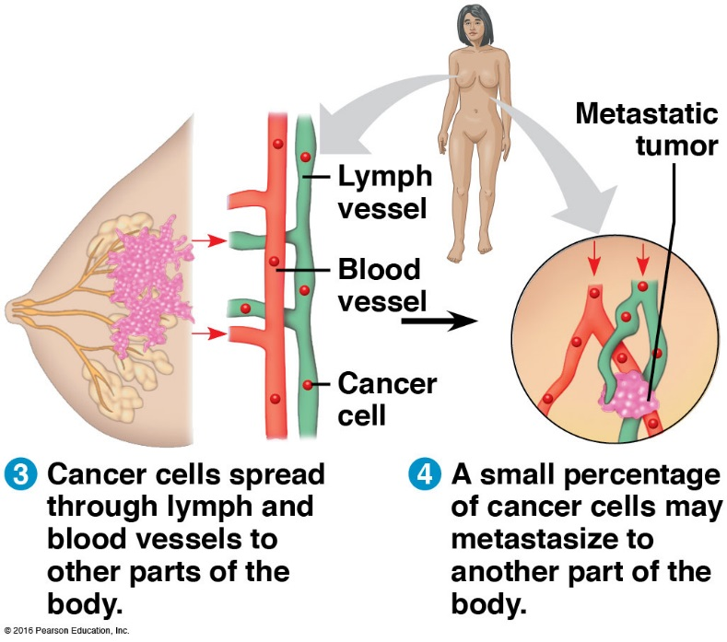
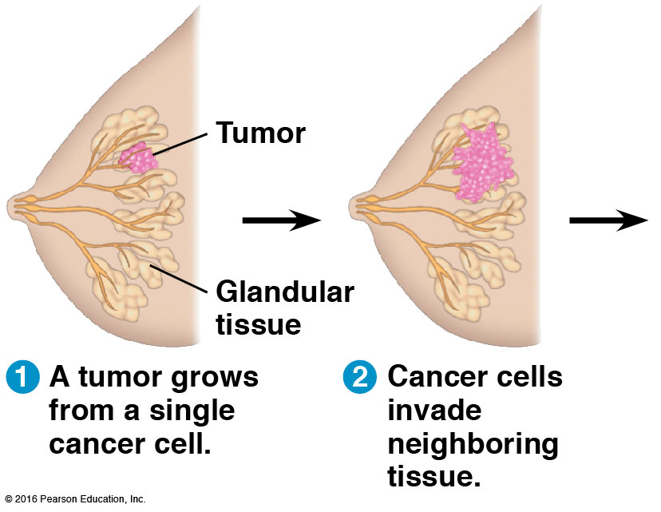
Transformation: Process that converts a normal cell to a cancer cell
Tumors = A mass of abnormal cells
Benign tumor: lump of cells remain at original site
Malignant tumor: invasive - impairs functions of 1+ organs (called cancer)
Metastasis: cells separate from tumor and travel to other parts of body

Slide 54
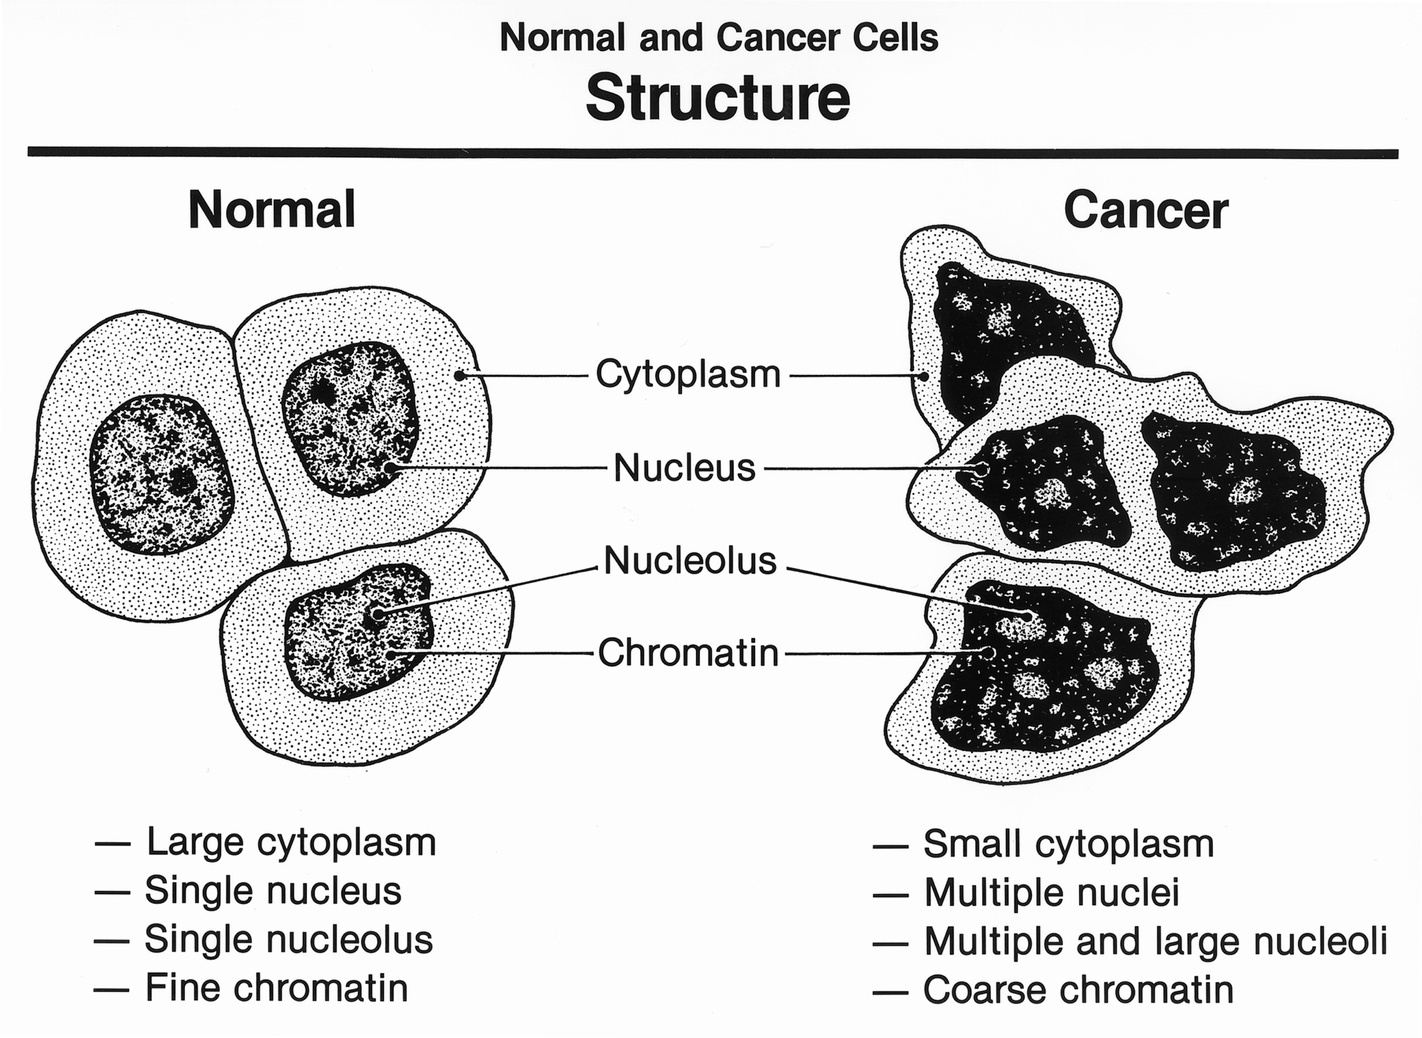

Slide 55
Cancer Cells
Some have abnormal #’s of chromosomes
Metabolism disabled
Lose attachment to ECM → spread to other tissues
Signaling molecules cause blood vessels to grow toward tumor
Treatment:
Surgery, radiation, chemotherapy
Personalized Medicine:
  Breast Cancer: 20-25% tumors show high HER2 receptors → use Herceptin to block HER2 protein

Slide 56
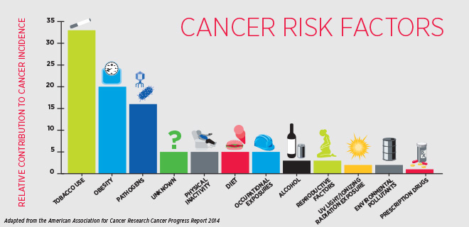
Cancer Risk Factors

Slide 57
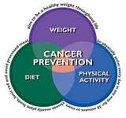
Cancer Prevention
Anyone can get cancer but there are ways to
minimize risk:
Don’t smoke, legal or illegal (includes hookahs, chew, 2nd-hand smoke)
Use sun protection
Exercise and keep weight at ideal level
Eat 5-7 servings of fruit and veggies a day
Use screening/preventative measures-breast/testicle/mole checks
Practice abstinence or use condoms
Vaccines (eg. HPV)

Slide 58
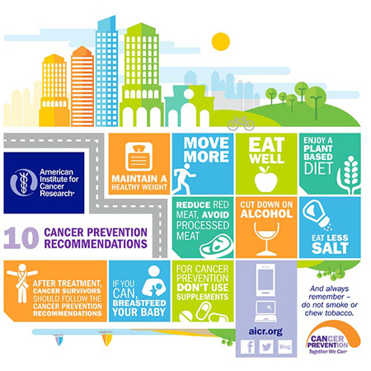

Slide 59
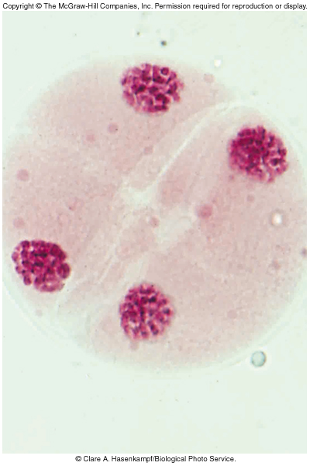
Sexual Reproduction and Meiosis

Slide 60
Chromosomes
Somatic (body) cell: 2n = 46 chromosomes
Each pair of homologous chromosomes includes 1 chromosome from each parent
Autosomes: 22 pairs of chromosomes that do not determine sex
Sex chromosomes: X and Y
  Females: XX
  Males: XY
Gametes (n=23): 22 autosomes + 1 sex chromosome
  Egg: 22 + X
  Sperm: 22 + X **or** 22 + Y

Slide 61
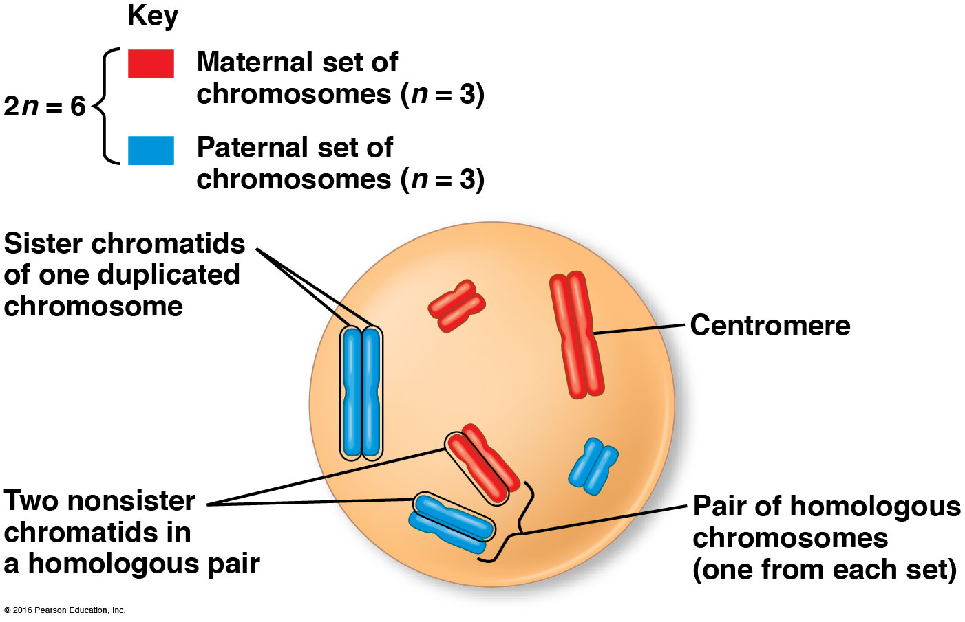
Homologous Chromosomes in a Somatic Cell

Slide 62
Meiosis
Meiosis is the process of a diploid cell dividing to produce four Hapliod cell Daughter Cells.
These haploid cells are called Gametes or sex Cells.
Meiosis is the reason for variation in the Genome of Organisms.
The cells that go under meiosis are located in the testes of males and the ovaries of females.

Slide 63
Meiosis is a form of cell division that leads to the production of gametes.
gametes: egg cells and sperm cells
-contain half the number of chromosomes of an adult body cell
Adult body cells (somatic cells) are diploid, containing 2 sets of chromosomes.
Gametes are haploid, containing only 1 set of chromosomes.

Slide 64
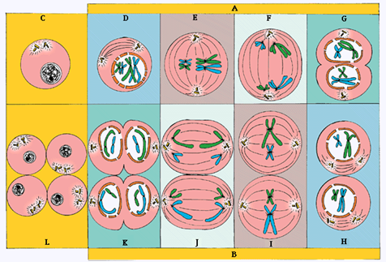

Slide 65
The Process of Meiosis
Prophase I:
-chromosomes coil tighter
-nuclear envelope dissolves
-homologues become closely associated in synapsis
-crossing over occurs between non-sister chromatids

Slide 66
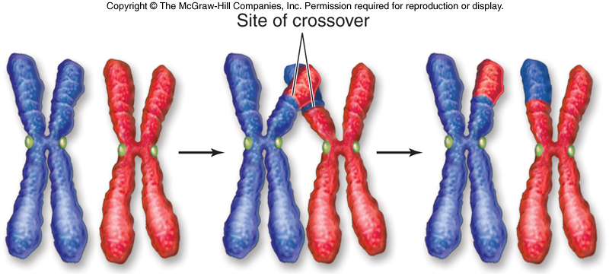

Slide 67
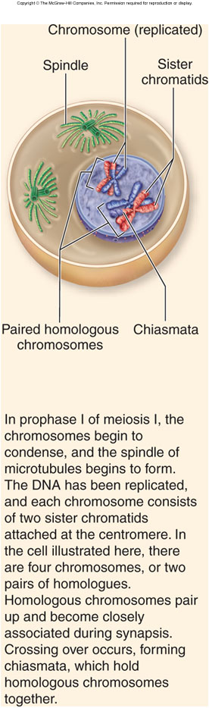

Slide 68
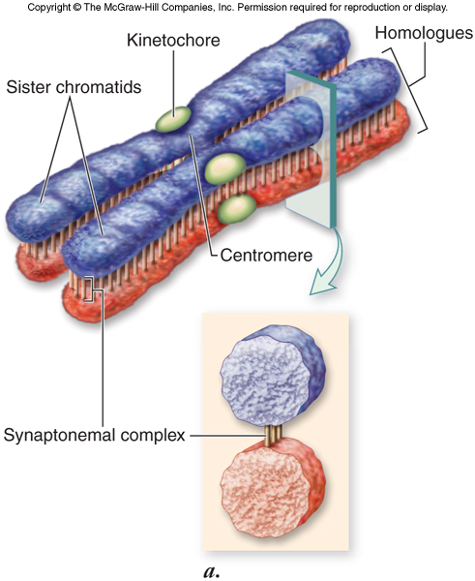

Slide 69
The Process of Meiosis
Metaphase I:
-terminal chiasmata hold homologues together following crossing over
chiasmata: sites of crossing over
-microtubules from opposite poles attach to each homologue, not each sister chromatid
-homologues are aligned at the metaphase plate side-by-side
- Independent Assortment occurs during this stage.

Slide 70
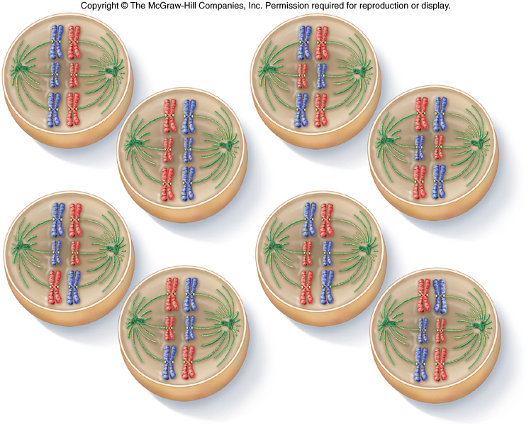

Slide 71
The Process of Meiosis
Anaphase I:
-microtubules of the spindle shorten
-homologues are separated from each other
-sister chromatids remain attached to each other at their centromeres

Slide 72
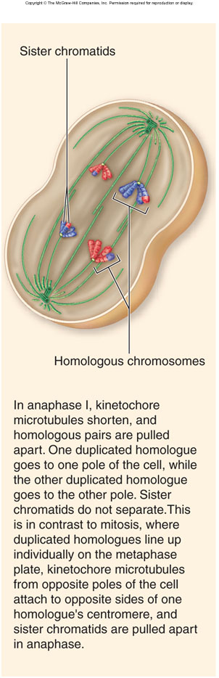

Slide 73
The Process of Meiosis
Telophase I:
-nuclear envelopes form around each set of chromosomes
-each new nucleus is now haploid
-sister chromatids are no longer identical because of crossing over

Slide 74
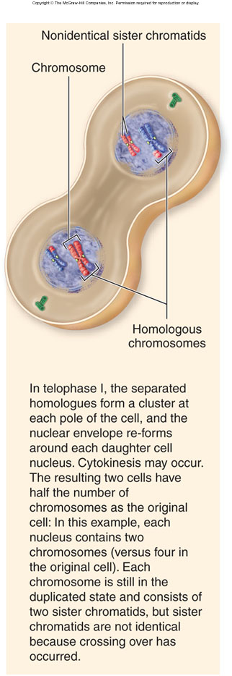

Slide 75
Meiosis II
Meiosis II resembles a mitotic division:
-prophase II: nuclear envelopes dissolve and spindle apparatus forms
-metaphase II: chromosomes align on metaphase plate
-anaphase II: sister chromatids are separated from each other
-telophase II: nuclear envelope re-forms; cytokinesis follows

Slide 76
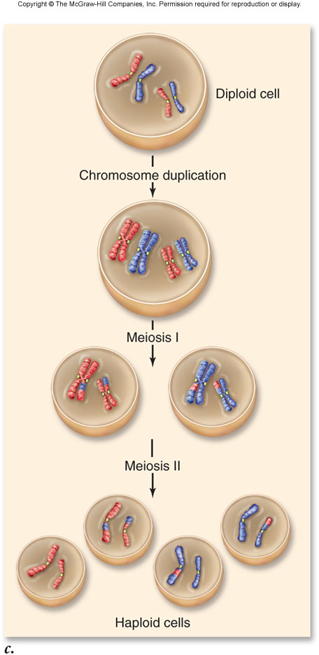

Slide 77
Sexual reproduction includes the fusion of gametes (fertilization) to produce a diploid zygote.
Life cycles of sexually reproducing organisms involve the alternation of haploid and diploid stages.
Some life cycles include longer diploid phases, some include longer haploid phases.

Slide 78
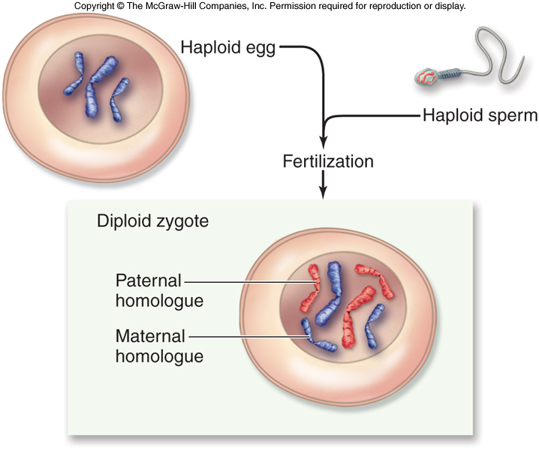

Slide 79
karyotype: the particular array of chromosomes of an organism

Slide 80
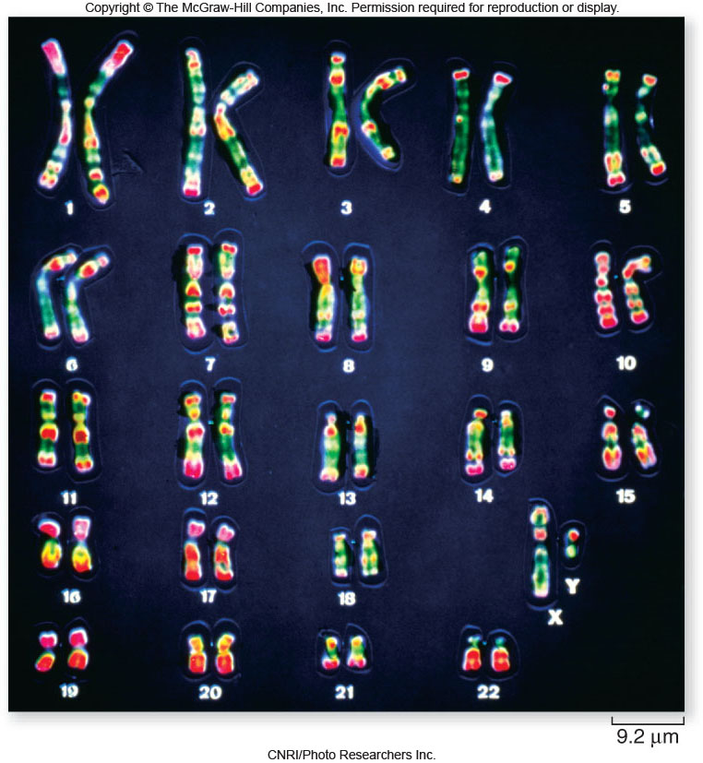

Slide 81
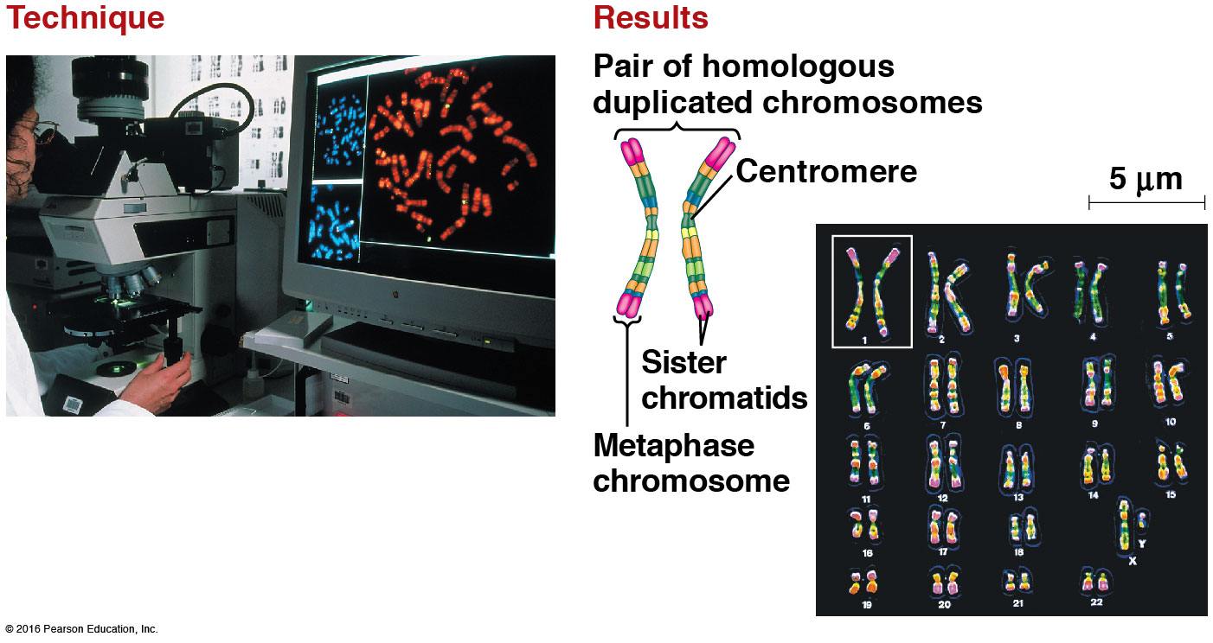
Karyotype: a picture of an organism’s complete set of chromosomes
Arranged from largest → smallest pair

Slide 82

Making a karyotype – unsorted chromosomes

Slide 83

22 pairs of autosomes + 1 pair of sex chromosomes
Male or female?

Slide 84

Karyotype - used to determine genetic abnormalities

Slide 85

Cancer cells
Some have abnormal #’s of chromosomes
Karyotype of Metastatic Melanoma

Slide 86

Breast Cancer Cell Karyotype

Slide 87
Types of Reproduction
ASEXUAL
Produces clones (genetically identical)
Single parent
Little variation in population - only through mutations
Fast and energy efficient
Eg. budding, binary fission
SEXUAL
Meiosis produces gametes (sex cells)
2 parents: male/female
Lots of variation/diversity
Slower and energy consumptive
Eg. humans, trees

Slide 88

Asexual vs. sexual reproduction

Slide 89

Varieties of Sexual Life Cycles

Slide 90

Animals

Slide 91

Alternation of Generations
Plant and some algae
Sporophyte (2n): makes haploid spores by meiosis
Spore → gametophyte by mitosis
Gametophyte (n): makes haploid gametes by mitosis

Slide 92
Human Genetic Disorders
Some genetic disorders are caused by a change in the number of chromosomes.
nondisjunction during meiosis can create gametes having one too many or one too few chromosomes
fertilization of these gametes creates trisomic or monosomic individuals
Down syndrome is trisomy of chromosome 21

Slide 93


Slide 94
Human Genetic Disorders
Nondisjunction of sex chromosomes can result in:
XXX triple-X females
XXY males (Klinefelter syndrome)
XO females (Turner syndrome)
OY nonviable zygotes
XYY males (Jacob syndrome)

Slide 95
1. Down Syndrome: Trisomy chromosome #21. 1 in 770 live births.
Low muscle tone, broad hands, thick neck , retardation.

Slide 96
2 Al-aish Syndrome: Monosomy #21. Lethal. Very rare. 3 known cases.

Slide 97
3. Edwards Syndrome: Trisomy 18. 1 - 4500 births.
Deaths usually by 6 months. 78% females. Rocker bottom feet.
80% have heart deformities.

Slide 98
4. Patau Syndrome: Trisomy 13. 1 - 5000 births.
Death by 1 month. Incomplete forebrain development. Cleft lip and
Palate and heart disorder.

Slide 99
Sex Chromosomes aneuploidy:
1. Turner Syndrome: Missing a sex chromosomes. (45 chromosomes)
(XO) 1 - 3000 female births. Short, bigger ears, web neck, sterile. May have a lower IQ.

Slide 100
Sex Chromosomes aneuploidy:
2. Klinefelters syndrome: One extra chromosome. (47 chromosomes) (XXY) 1 - 500 male births. Limbs longer than
average. Tall. Sterile, Breast Development. low IQ.

Slide 101
Sex Chromosomes aneuploidy:
3. Jacob Syndrome: (XYY) 1 - 1000 male births. Tall 6ft or more.
Antisocial, Aggressive, Violent (Criminal Behavior) Low IQ.

Slide 102


Slide 103
Human Genetic Disorders
genomic imprinting occurs when the phenotype exhibited by a particular allele depends on which parent contributed the allele to the offspring
a specific partial deletion of chromosome 15 results in:
Prader-Willi syndrome if the chromosome is from the father
Angelman syndrome if it’s from the mother

Slide 104
http://highered.mheducation.com/sites/0072495855/student_view0/chapter28/animation__how_meiosis_works.html

